Slide 1

Quantum Computing
10. Quantum algorithms (2)
Quantum Computing Insitute
https://qcict.org
Prof. Aleksandar Radovanovic
alex@qcict.org

Slide 2
Content
Grover algorithm
Shor's algorithm

Slide 3
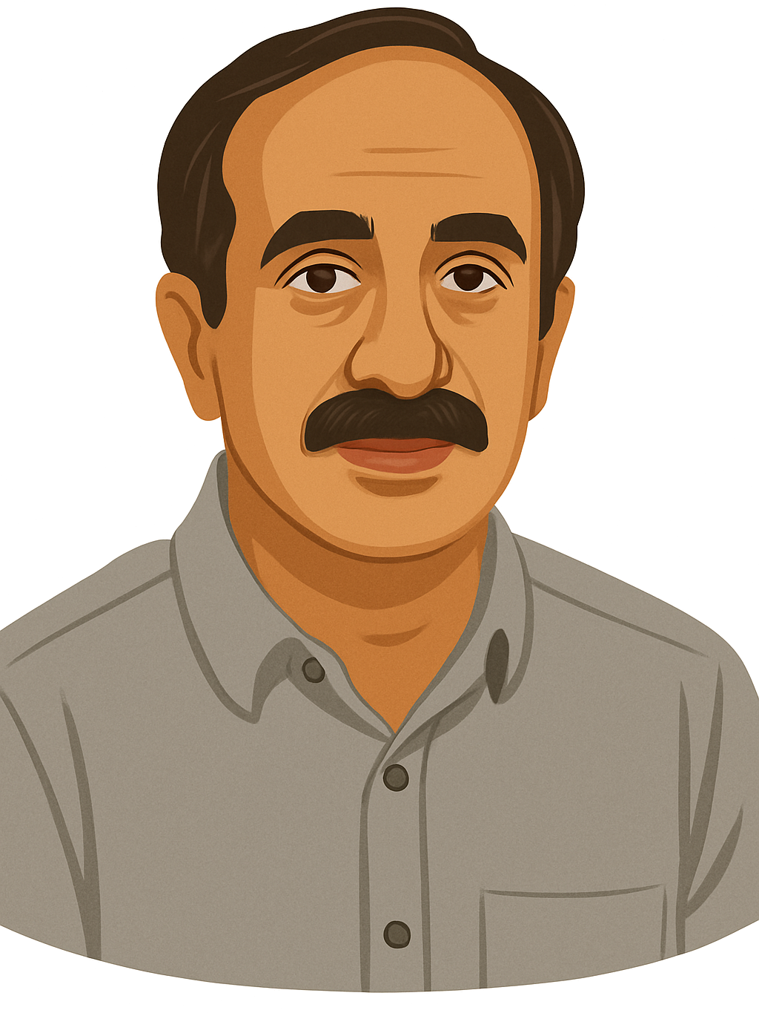
Grover’s Algorithm (1996)
Grover’s algorithm provides a quadratic speedup for searching an unstructured set of data compared with classical search.
Grover L.K.: A fast quantum mechanical algorithm for database search, Proceedings, 28th Annual ACM Symposium on the Theory of Computing, (May 1996) p. 212
Lov Grover (born 1961)
Notes:
At the 1996 ACM Symposium, Indian-American computer scientist Lov Grover presented his paper, “A Fast Quantum Mechanical Algorithm for Database Search.” In this work, he introduced a quantum algorithm that can search unstructured data significantly faster than classical methods. Today, this algorithm is widely known as Grover’s algorithm.
References:
Grover L.K.: A fast quantum mechanical algorithm for database search, Proceedings, 28th Annual ACM Symposium on the Theory of Computing, (May 1996) p. 212
https://arxiv.org/abs/quant-ph/9605043

Slide 4

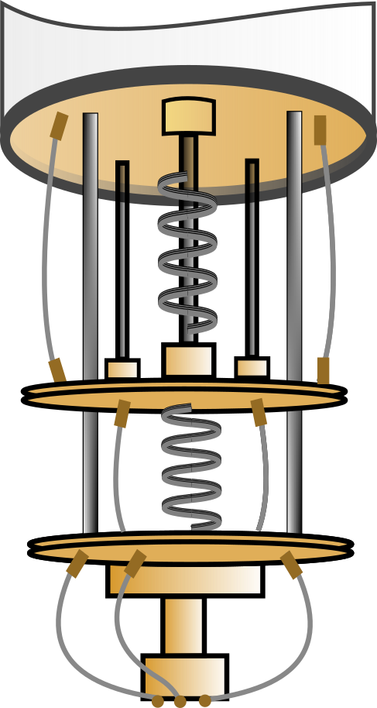


Grover’s Algorithm: Quadratic Speedup
N: 1 trillion (${10}^{12}$) records / 1 µs: time to check 1 record
Classical computer
Quantum computer
N/2 queries
time: ~ 6 days
$$\sqrt{N}$$
queries
time: ~ 1 second
Notes:
Grover's algorithm does not directly solve the search problem, but it shows that the number of queries needed to find a solution can be quadratically smaller on a quantum computer than on a classical one.
Imagine a box full of unsorted address cards. The classical method for finding a specific card relies on trial and error: draw a card, check whether it is the right one, and repeat. You might get lucky and find it on the first try, but in the worst case, it will be the last one you check. On average, you would go through about half the cards before finding the correct one.
In the quantum version, all possible card indices are put into superposition and sent to an oracle. The oracle marks the correct index, and quantum interference then amplifies the amplitude of that state. When we measure the register, the correct index is obtained with high probability.
Suppose we want to find a specific entry among one trillion (10¹²) unsorted records using both classical and quantum computers. For this simplified comparison, assume that each query takes one microsecond.
A classical computer would require, on average, about half a trillion queries, taking approximately six days.
A quantum computer using Grover's algorithm would require on the order of $\sqrt{{10}^{12}}={10}^{6}$ queries, corresponding to about one second in this simplified example.
This illustrates Grover's quadratic speedup: the number of required queries scales as $O(\sqrt{N}$), compared with $O(N$) for classical search.

Slide 5

Finding Eve: Grover’s Search in Action
Leo
11
Ben
Eve
01
10
Mia
00
(11, 10, 00, 01)
Notes:
The operation of Grover’s algorithm can be illustrated with a simple example, shown in the diagram. Imagine a small phone directory with four unsorted entries, each labelled by a binary index. Since two qubits can represent 2²=4 possible indices, two qubits are enough to perform this search. The goal is to find Eve’s phone number. In this example, the search is performed by index rather than by name, so the algorithm searches for the entry marked 10.
In a real-world application, the search space could contain millions of unsorted items, such as phone numbers, records, dates, or database entries.

Slide 6

Four Steps of Grover’s Algorithm
1
Equal superposition
2
Oracle
3
Amplification (diffusion)
4
Measurement
-1/2
-1/2
-1/2
Outcome
10
Amplitude
0
00
01
10
11
0
00
01
10
11
0
00
01
10
11
-1/2
-1/2
-1/2
$$H^{⨂2}$$
O
D
All four indices have the same positive amplitude
The oracle inverts the sign of the amplitude of the target state |10⟩
(Eve’s phone number)
The diffuser amplifies the marked state |10⟩
(Eve’s entry)
and reduces the amplitudes of the others
Measurement returns the target index 10
(Eve’s entry)
with high probability
Notes:
Grover’s algorithm performs the search in four main steps:
Superposition: First, the qubits are placed into an equal superposition, representing all four directory indices at once.
Oracle: Next, the oracle, which is designed to recognize Eve’s entry, marks the target state $\left|x^{∗}\right\rangle =\left|10\right\rangle$ by flipping the sign of its amplitude.
Amplification: The amplitude of the marked state ∣10⟩ is amplified, while the amplitudes of the other states decrease. If necessary, the oracle and amplification steps are repeated.
Measurement: Finally, ∣10⟩ has the largest amplitude, so measurement returns 10, the index of Eve’s phone number, with high probability.
The diagram below the amplitudes shows the operations used in each step. $H^{⨂2}$ creates the equal superposition, O represents the oracle, and D, called the diffusion operator or diffuser, performs amplitude amplification. Finally, measurement returns the search result.

Slide 7
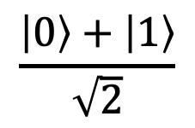
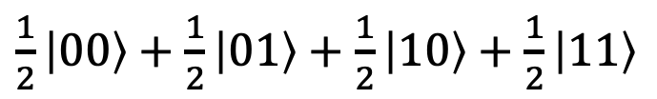
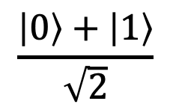
Step 1: Creating an Equal Superposition
$$\frac{\left|0\right\rangle +\left|1\right\rangle }{\sqrt{2}}$$
|0⟩
H
$\frac{1}{2}\left|00\right\rangle +\frac{1}{2}\left|01\right\rangle +$ $\frac{1}{2}\left|10\right\rangle +$ $\frac{1}{2}\left|11\right\rangle$
|0⟩
H
$$\frac{\left|0\right\rangle +\left|1\right\rangle }{\sqrt{2}}$$
Notes:
In the first step of Grover’s algorithm, Hadamard gates are applied to all qubits, creating an equal superposition in which the basis states represent all possible indices.
For example, with two qubits, the four indices are represented by the basis states ∣00⟩, ∣01⟩, ∣10⟩, and ∣11⟩. In this equal superposition, every basis state has the same probability amplitude.

Slide 8
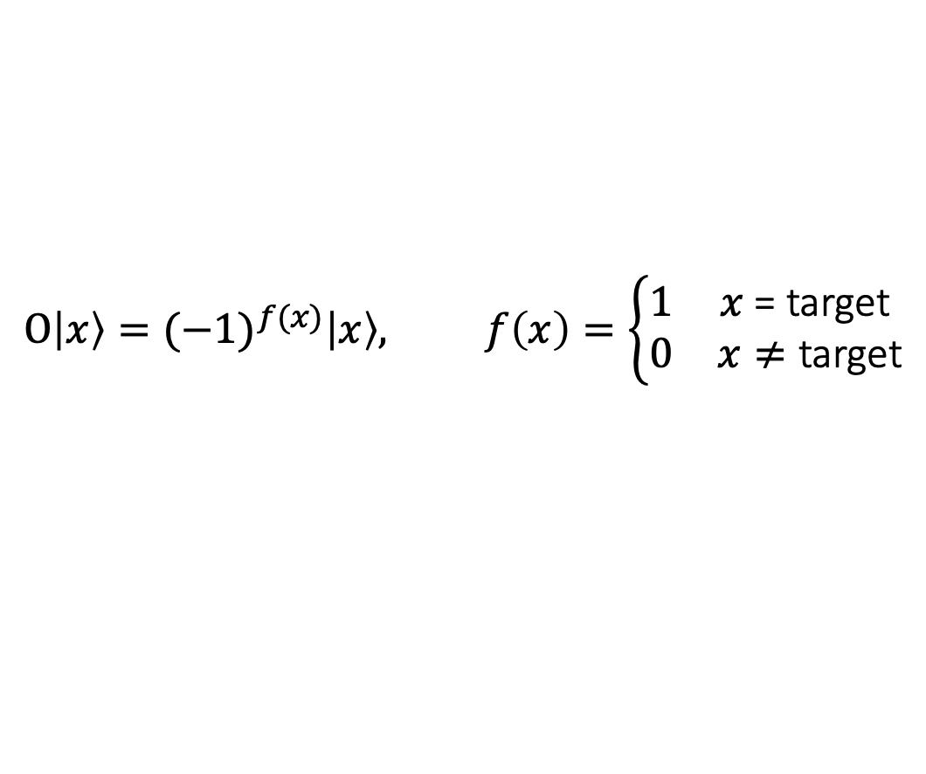
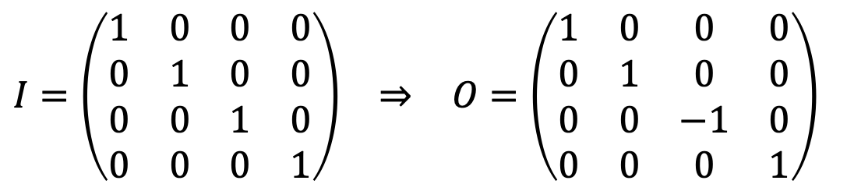
Step 2: Amplitude Flip by the Oracle
$$O\left|x\right\rangle ={(−1)}^{f(x)}\left|x\right\rangle , f\left(x\right)=\left\{\begin{matrix}1 & \text{x}\text{ = }\text{target} \\ 0 & \text{x}≠\text{target}\end{matrix}\right.$$
$$\begin{matrix}I=\left(\begin{matrix}1 & 0 & 0 & 0 \\ 0 & 1 & 0 & 0 \\ 0 & 0 & 1 & 0 \\ 0 & 0 & 0 & 1\end{matrix}\right) & ⇒ & O=\left(\begin{matrix}1 & 0 & 0 & 0 \\ 0 & 1 & 0 & 0 \\ 0 & 0 & −1 & 0 \\ 0 & 0 & 0 & 1\end{matrix}\right)\end{matrix}$$
Notes:
In the second step, the oracle identifies and marks the target index by flipping the sign of its amplitude. In general, the oracle acts as a phase operator:
$$O\left|x\right\rangle ={(−1)}^{f(x)}\left|x\right\rangle$$
where $f\left(x\right)=1$ for the target state and $f\left(x\right)=0$for all other states. This means that the oracle multiplies the amplitude of the target state by −1, while leaving all other amplitudes unchanged.
Its matrix is simply the identity matrix with the diagonal entry corresponding to the target state changed from +1 to −1. In this example, the target is ∣10⟩, so the oracle changes its amplitude from positive to negative while all other amplitudes remain the same.

Slide 9
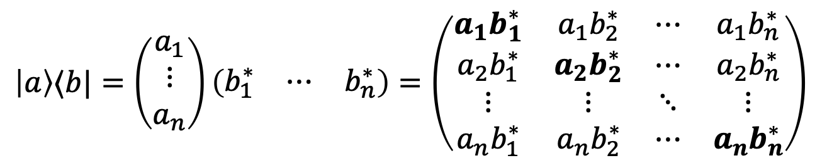
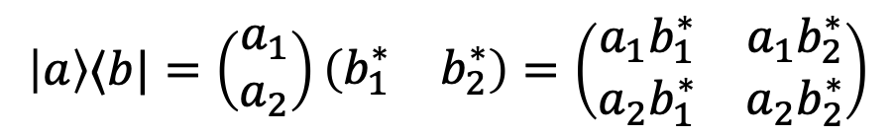
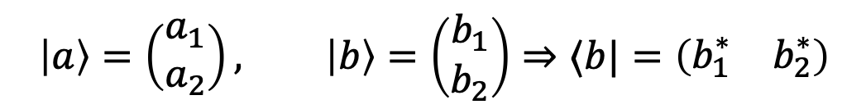
MathBox: Outer Product
The outer product is the product of a ket vector and a bra vector::
$$\left|a\right\rangle =\left(\begin{matrix}a_{1} \\ a_{2}\end{matrix}\right), \left|b\right\rangle =\left(\begin{matrix}b_{1} \\ b_{2}\end{matrix}\right)⇒⟨b|=\left(\begin{matrix}b_{1}^{∗} & b_{2}^{∗}\end{matrix}\right)$$
$$\left|a\right\rangle ⟨b|=\left(\begin{matrix}a_{1} \\ a_{2}\end{matrix}\right)\left(\begin{matrix}b_{1}^{∗} & b_{2}^{∗}\end{matrix}\right)=\left(\begin{matrix}a_{1}b_{1}^{∗} & a_{1}b_{2}^{∗} \\ a_{2}b_{1}^{∗} & a_{2}b_{2}^{∗}\end{matrix}\right)$$
In general:
$\left|a\right\rangle ⟨b|=\left(\begin{matrix}a_{1} \\ ⋮ \\ a_{n}\end{matrix}\right)\left(\begin{matrix}b_{1}^{∗} & ⋯ & b_{n}^{∗}\end{matrix}\right)=\left(\begin{matrix}a_{1}b_{1}^{∗} & a_{1}b_{2}^{∗} & ⋯ & a_{1}b_{n}^{∗} \\ a_{2}b_{1}^{∗} & a_{2}b_{2}^{∗} & ⋯ & a_{2}b_{n}^{∗} \\ ⋮ & ⋮ & ⋱ & ⋮ \\ a_{n}b_{1}^{∗} & a_{n}b_{2}^{∗} & ⋯ & a_{n}b_{n}^{∗}\end{matrix}\right)$
Notes:
To formally describe the oracle and the diffusion operator, we first need to introduce the outer product notation.
The outer product is the product of a ket and a bra vector. It produces a matrix whose entries are the products of each ket component with each bra component.

Slide 10



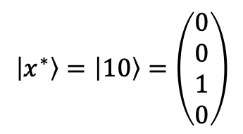

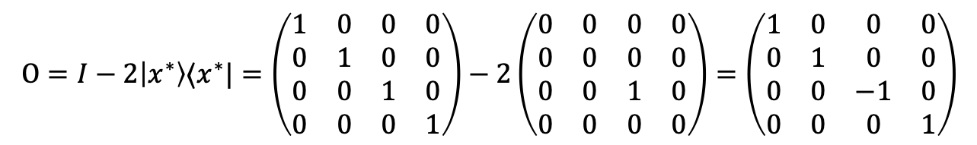

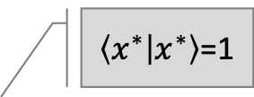


Grover Oracle: Operator Construction
For the target state $\left|x^{∗}\right\rangle$ the oracle action is
$$O\left|x^{∗}\right\rangle =−\left|x^{∗}\right\rangle$$
or
$$O\left|x^{∗}\right\rangle =\left|x^{∗}\right\rangle −2\left|x^{∗}\right\rangle$$
$\left\langle x^{∗} | x^{∗}\right\rangle$=1
$$I\left|x^{∗}\right\rangle$$
$$2\left|x^{∗}\right\rangle \left\langle x^{∗} | x^{∗}\right\rangle$$
$$O\left|x^{∗}\right\rangle =\left(I−2\left|x^{∗}\right\rangle ⟨x^{∗}|\right) \left|x^{∗}\right\rangle$$
$$O=I−2\left|x^{∗}\right\rangle ⟨x^{∗}|$$
For the phone-directory example
$$\left|x^{∗}\right\rangle =\left|10\right\rangle =\left(\begin{matrix}0 \\ 0 \\ 1 \\ 0\end{matrix}\right)$$
$$O=I−2\left|x^{∗}\right\rangle ⟨x^{∗}|=\left(\begin{matrix}1 & 0 & 0 & 0 \\ 0 & 1 & 0 & 0 \\ 0 & 0 & 1 & 0 \\ 0 & 0 & 0 & 1\end{matrix}\right)−2\left(\begin{matrix}0 & 0 & 0 & 0 \\ 0 & 0 & 0 & 0 \\ 0 & 0 & 1 & 0 \\ 0 & 0 & 0 & 0\end{matrix}\right)=\left(\begin{matrix}1 & 0 & 0 & 0 \\ 0 & 1 & 0 & 0 \\ 0 & 0 & −1 & 0 \\ 0 & 0 & 0 & 1\end{matrix}\right)$$
Notes:
The oracle must flip the phase of the marked (target) state $\left|x^{∗}\right\rangle$, so its action is
$$O\left|x^{∗}\right\rangle =−\left|x^{∗}\right\rangle$$
The same transformation can be written as
$$O\left|x^{∗}\right\rangle =\left|x^{∗}\right\rangle −2\left|x^{∗}\right\rangle$$
The first term can be written using the identity operator, $I\left|x^{∗}\right\rangle$ , while the second term can be expressed using the fact that $\left\langle x^{∗} | x^{∗}\right\rangle =1$. Therefore,
$$O\left|x^{∗}\right\rangle =I\left|x^{∗}\right\rangle −2\left|x^{∗}\right\rangle \left\langle x^{∗} | x^{∗}\right\rangle =\left(I−2\left|x^{∗}\right\rangle ⟨x^{∗}|\right)\left|x^{∗}\right\rangle$$
This gives the general oracle operator
$$O=I−2\left|x^{∗}\right\rangle ⟨x^{∗}|$$
For the phone-directory example, the target is
$$\left|x^{∗}\right\rangle =\left|10\right\rangle =\left(\begin{matrix}0 \\ 0 \\ 1 \\ 0\end{matrix}\right)$$
Substituting this state gives
$$\begin{matrix}O= & I−2\left|x^{∗}\right\rangle ⟨x^{∗}| \\ = & \left(\begin{matrix}1 & 0 & 0 & 0 \\ 0 & 1 & 0 & 0 \\ 0 & 0 & 1 & 0 \\ 0 & 0 & 0 & 1\end{matrix}\right)−2\left(\begin{matrix}0 \\ 0 \\ 1 \\ 0\end{matrix}\right)\left(\begin{matrix}0 & 0 & 1 & 0\end{matrix}\right) \\ = & \left(\begin{matrix}1 & 0 & 0 & 0 \\ 0 & 1 & 0 & 0 \\ 0 & 0 & 1 & 0 \\ 0 & 0 & 0 & 1\end{matrix}\right)−2\left(\begin{matrix}0 & 0 & 0 & 0 \\ 0 & 0 & 0 & 0 \\ 0 & 0 & 1 & 0 \\ 0 & 0 & 0 & 0\end{matrix}\right) \\ = & \left(\begin{matrix}1 & 0 & 0 & 0 \\ 0 & 1 & 0 & 0 \\ 0 & 0 & −1 & 0 \\ 0 & 0 & 0 & 1\end{matrix}\right)\end{matrix}$$
This produces exactly the oracle introduced earlier: the identity matrix with the diagonal element corresponding to the target ∣10⟩ changed from +1 to −1.

Slide 11








Grover Oracle: Quantum Gate Implementation
$$\left|11\right\rangle$$
$$−\left|11\right\rangle$$
$$\left|10\right\rangle$$
$$−\left|10\right\rangle$$
Z
+
Z
+
+
+
+
+
$$\left|00\right\rangle$$
$$−\left|00\right\rangle$$
$$\left|01\right\rangle$$
$$−\left|01\right\rangle$$
+
Z
+
Z
Notes:
At the circuit level, the oracle is constructed to flip the phase, or sign, of the target state’s amplitude, while leaving all other states unchanged.
For the two-qubit example, a CZ gate can perform this operation. The CZ gate is activated only when both qubits are in state ∣1⟩, so ∣11⟩→−∣11⟩. If the desired target contains a 0, an X gate is placed before and after the corresponding qubit. This temporarily converts the target pattern into ∣11⟩, allowing the CZ gate to recognize it. The final X gate then restores the original basis state.
For the target ∣10⟩, the X gates are applied to the second qubit, temporarily converting ∣10⟩ into ∣11⟩. In this way, the circuit implements the required oracle and flips only the amplitude of the target state.

Slide 12
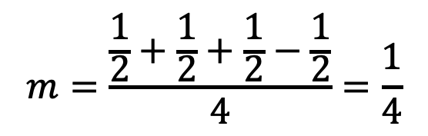
Step 3: Amplitude Amplification
$$m=\frac{\frac{1}{2}+\frac{1}{2}+\frac{1}{2}−\frac{1}{2}}{4}=\frac{1}{4}$$
Notes:
The third step of Grover’s algorithm is amplitude amplification. The diffuser performs this step by inverting all amplitudes about their mean, or average value. In this example, the average amplitude after the oracle is$m=1/4$. After the inversion, the amplitude of the marked state becomes the largest, while the amplitudes of the other states become zero.
In general, this does not always happen. The oracle and amplification steps may need to be repeated several times to make the target amplitude sufficiently large.

Slide 13

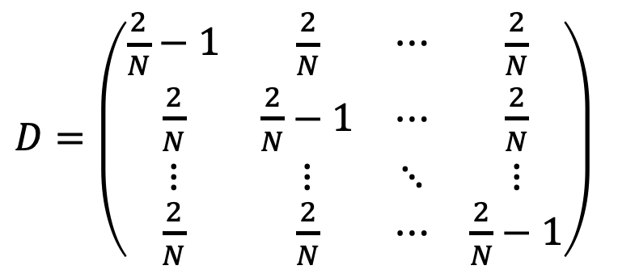
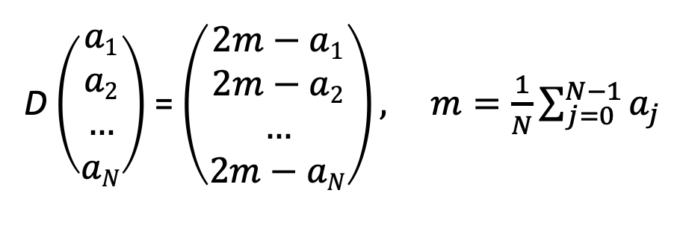
Step 3: Diffusion Operator: Inversion About the Mean
D $\left(\begin{matrix}a1 \\ a2 \\ … \\ aN\end{matrix}\right)$ = $\left(\begin{matrix}2m−a1 \\ 2m−a2 \\ … \\ 2m−aN\end{matrix}\right), m=\frac{1}{N}\sum_{j=0}^{N−1}{a_{j}}$
(1)
$D=\left(\begin{matrix}\frac{2}{N}−1 & \frac{2}{N} & ⋯ & \frac{2}{N} \\ \frac{2}{N} & \frac{2}{N}−1 & ⋯ & \frac{2}{N} \\ ⋮ & ⋮ & ⋱ & ⋮ \\ \frac{2}{N} & \frac{2}{N} & ⋯ & \frac{2}{N}−1\end{matrix}\right)$
(2)
$$reflection: \left(x,y\right) →\left(x,2m−y\right)$$
Notes:
The idea of inversion about the mean can also be pictured geometrically. Imagine a point with coordinates $\left(x,y\right)$. If we reflect it across a horizontal line at height $y=m$, the new point will be at $\left(x,2m−y\right)$.
The same idea can be applied to a set of probability amplitudes. If their average value is$m$, the diffusion operator $D$ transforms each amplitude $a_{i}$​ according to $2m−ai$. In other words, amplitudes below the average move above it, while amplitudes above the average move below it. This transformation can be written as a matrix operation. Since the average amplitude is
$$m=\frac{1}{N}\sum_{j=0}^{N−1}{a_{j}}$$
each new amplitude becomes
$$a^{′}i=2m−a_{i}=\frac{2}{N}\sum_{j=0}^{N−1}{a_{j}}−a_{i}$$
This means that the coefficient multiplying $a_{i}$​ is $(2/N−1)$, while the coefficient multiplying every other amplitude is $2/N$. These coefficients form the diffusion matrix $D$ shown on the slide.
Grover originally introduced this operation as the diffusion operator and later also used the more descriptive name inversion about the mean. The term diffusion operator remains widely used today.

Slide 14
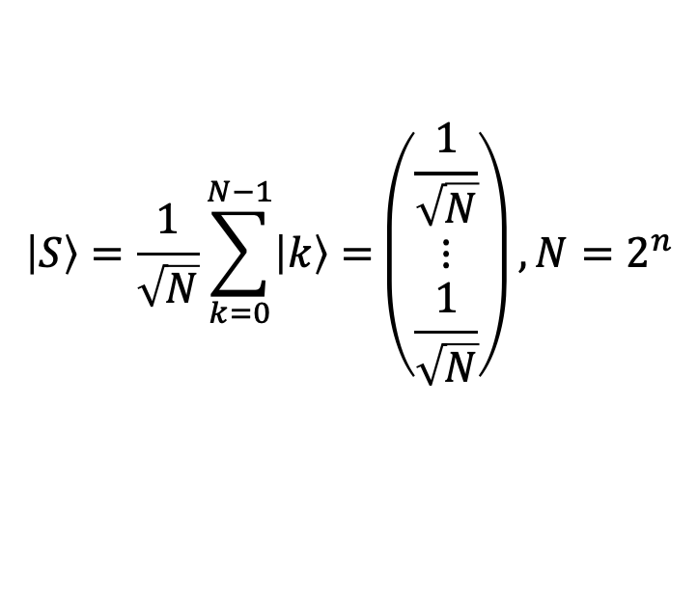

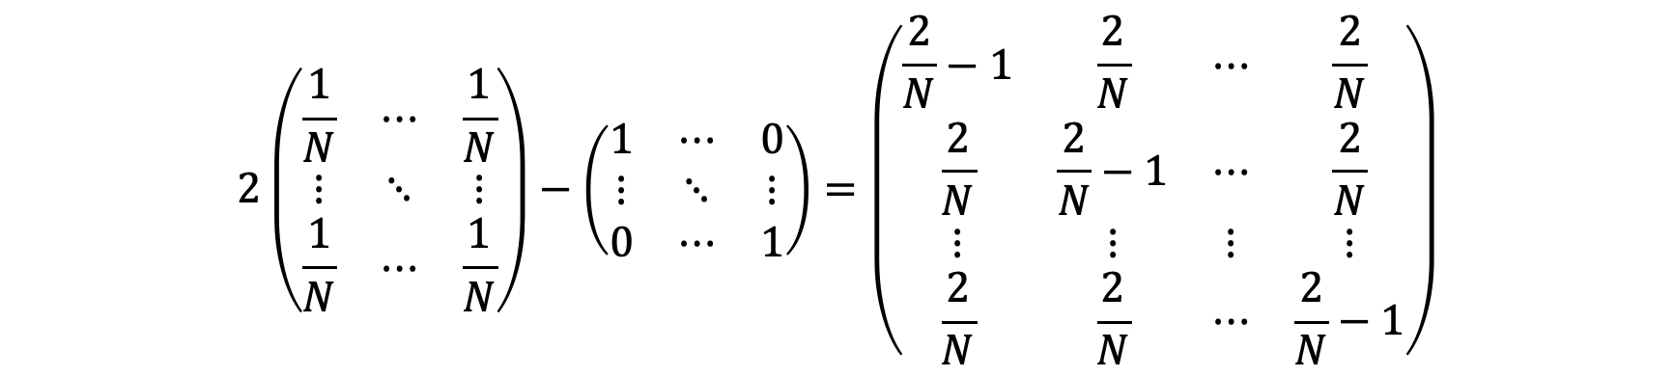
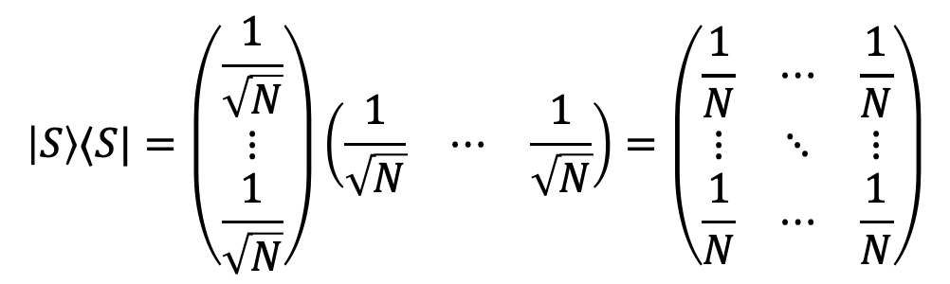
Step 3: Diffusion Operator: Mathematical Construction
$$\left|S\right\rangle =\frac{1}{\sqrt{N}}\sum_{k=0}^{N−1}{\left|k\right\rangle =}\left(\begin{matrix}\frac{1}{\sqrt{N}} \\ ⋮ \\ \frac{1}{\sqrt{N}}\end{matrix}\right), N=2^{n}$$
$$\left|S\right\rangle ⟨S|=\left(\begin{matrix}\frac{1}{\sqrt{N}} \\ ⋮ \\ \frac{1}{\sqrt{N}}\end{matrix}\right)\left(\begin{matrix}\frac{1}{\sqrt{N}} & ⋯ & \frac{1}{\sqrt{N}}\end{matrix}\right)=\left(\begin{matrix}\frac{1}{N} & ⋯ & \frac{1}{N} \\ ⋮ & ⋱ & ⋮ \\ \frac{1}{N} & ⋯ & \frac{1}{N}\end{matrix}\right)$$
$$2\left(\begin{matrix}\frac{1}{N} & ⋯ & \frac{1}{N} \\ ⋮ & ⋱ & ⋮ \\ \frac{1}{N} & ⋯ & \frac{1}{N}\end{matrix}\right)−\left(\begin{matrix}1 & ⋯ & 0 \\ ⋮ & ⋱ & ⋮ \\ 0 & ⋯ & 1\end{matrix}\right)=\left(\begin{matrix}\frac{2}{N}−1 & \frac{2}{N} & ⋯ & \frac{2}{N} \\ \frac{2}{N} & \frac{2}{N}−1 & ⋯ & \frac{2}{N} \\ ⋮ & ⋮ & ⋮ & ⋮ \\ \frac{2}{N} & \frac{2}{N} & ⋯ & \frac{2}{N}−1\end{matrix}\right)$$
$$D=2\left|S\right\rangle ⟨S|−I$$
Notes:
The diffusion operator can be constructed from the equal superposition state $\left|S\right\rangle$, where every basis state has the same amplitude $1/\sqrt{N}$​.
$$\left|S\right\rangle =\left(\begin{matrix}\frac{1}{\sqrt{N}} \\ ⋮ \\ \frac{1}{\sqrt{N}}\end{matrix}\right)$$
Taking the outer product of this state with itself gives a matrix in which every element is $1/N$:
$$\left|S\right\rangle ⟨S|=\left(\begin{matrix}\frac{1}{N} & ⋯ & \frac{1}{N} \\ ⋮ & ⋱ & ⋮ \\ \frac{1}{N} & ⋯ & \frac{1}{N}\end{matrix}\right)$$
Doubling the matrix and subtracting the identity changes the diagonal elements from $2/N$ to $(2/N−1)$, while all other elements remain $2/N$. The result is exactly the diffusion matrix introduced previously
$$D=2\left|S\right\rangle ⟨S|−I$$
Geometrically, $\left|S\right\rangle ⟨S|$ projects the state onto the direction of the equal superposition. Doubling this projection and subtracting the original state reflects the state about that direction. In terms of probability amplitudes, this produces the inversion about the mean $a_{i}→2m−a_{i}$. This is why the diffusion operator is also called the inversion-about-the-mean operator.

Slide 15
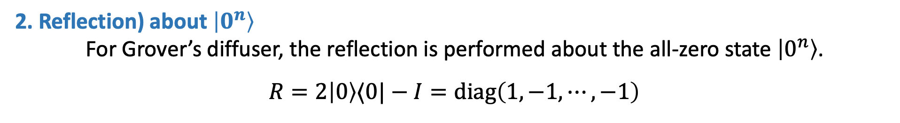
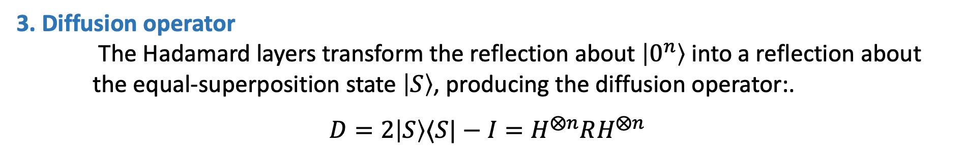
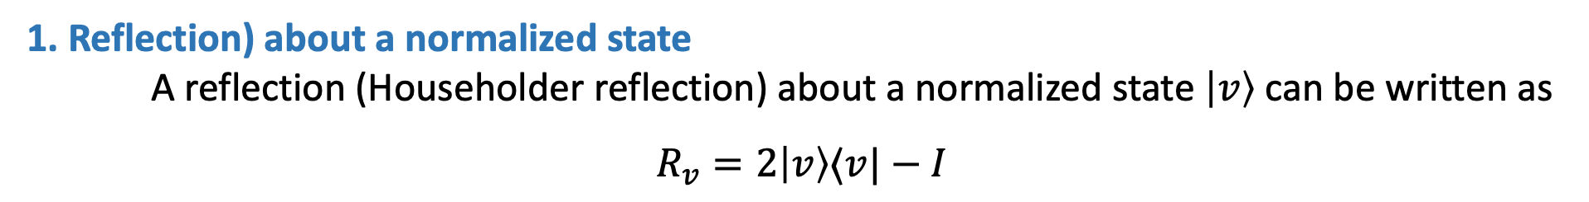
Step 3: Building Diffusion with Reflection
1. Reflection) about a normalized state
A reflection (Householder reflection) about a normalized state $\left|v\right\rangle$ can be written as
$$R_{v}=2\left|v\right\rangle ⟨v|−I$$
This operator leaves the component along $\left|v\right\rangle$ unchanged and flips all perpendicular components.
2. Reflection) about $\left|0^{n}\right\rangle$
For Grover’s diffuser, the reflection is performed about the all-zero state $\left|0^{n}\right\rangle$.
$$R=2\left|0\right\rangle ⟨0|−I=diag\left(1,−1,⋯,−1\right)$$
3. Diffusion operator
The Hadamard layers transform the reflection about $\left|0^{n}\right\rangle$ into a reflection about the equal-superposition state $\left|S\right\rangle$, producing the diffusion operator:.
$$D=2\left|S\right\rangle ⟨S|−I=H^{⨂n}RH^{⨂n}$$
Notes:
Grover also showed that the diffusion operator can be constructed using two Hadamard layers with a simple reflection operator placed between them. This operator has +1 for the state $\left|0^{n}\right\rangle$ and −1 for all other basis states.
In general, a reflection (formally Householder reflection) about a normalized state $\left|v\right\rangle$ can be written as $R_{v}=2\left|v\right\rangle ⟨v|−I$. This operator leaves the component along $\left|v\right\rangle$ unchanged and flips the sign of every component perpendicular to it.
For Grover’s diffuser, the reflection is performed about the all-zero state $\left|0^{n}\right\rangle$. Therefore, $R=2\left|0\right\rangle ⟨0|−I$, Since $\left|0^{n}\right\rangle ⟨0^{n}|=diag\left(1,0,⋯,0\right)$, we get $R=diag\left(1,−1,⋯,−1\right)$. The matrix $R$ has +1 for the state $\left|0^{n}\right\rangle$ and -1 for all other basis states.
The Hadamard layers transform the reflection about $\left|0^{n}\right\rangle$ into a reflection about the equal-superposition state $\left|S\right\rangle$, producing the diffusion operator:
$$D=2\left|S\right\rangle ⟨S|−I=H^{⨂n}RH^{⨂n}{=H}^{⨂n}\left(\begin{matrix}1 & 0 & ⋯ & 0 \\ 0 & −1 & ⋯ & 0 \\ ⋮ & ⋮ & ⋱ & ⋮ \\ 0 & 0 & ⋯ & −1\end{matrix}\right)H^{⨂n}$$
Thus, $D$ acts as a reflection about the equal-superposition state $\left|S\right\rangle$, which produces the inversion about the mean used for amplitude amplification.

Slide 16

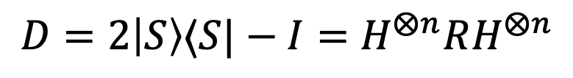

Constructing the Grover Diffuser
$$D=2\left|S\right\rangle ⟨S|−I=H^{⨂n}RH^{⨂n}$$
H
+
+
H
H
+
Z
+
H
$$R\sim X^{⨂2}CZX^{⨂2}$$
$$D\sim H^{⨂2}X^{⨂2}CZX^{⨂2}H^{⨂2}$$
Notes:
The reflection can be implemented, up to an irrelevant global phase, using X gates on both qubits and a CZ gate:
$$R\sim X^{⨂2}CZX^{⨂2}$$
Combining this with the outer Hadamard layers gives the complete two-qubit diffuser:
$$D\sim H^{⨂2}X^{⨂2}CZX^{⨂2}H^{⨂2}$$
The first layer of H gates changes from computational to X-basis, where the "average state" is just |00>.
The X gates turn |00> into |11>.
The CZ flips the sign of |11>.
The second layer of X gates turns |11> back to |00>, but the minus sign stays.
The final layer of H gates changes the basis back to computational, resulting in inversion about the average.
The oracle determines which state is the target and marks it by a phase flip. The diffuser does not need to know which state was marked; it simply inverts all amplitudes about their average. As a result, the amplitude modified by the oracle becomes amplified. Unlike the oracle, which depends on the target being searched for, the diffuser has the same structure for a given number of qubits.

Slide 17
Step 4: Measurement
10
Notes:
At the final step, measurement returns the target index with the highest probability. In this simple example, that probability is 100%. For larger data sets, it is generally lower, but repeating the oracle and amplification steps the appropriate number of times makes the target state stand out strongly enough to be measured with high probability.

Slide 18
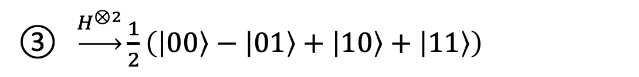

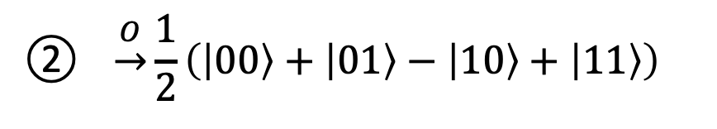
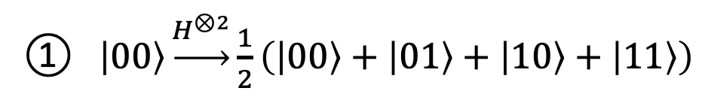


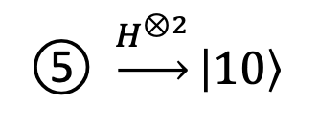
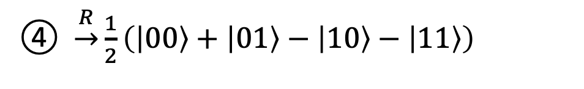

Grover’s Algorithm: State Evolution for N=4
R
$$\left|0\right\rangle →\left|0\right\rangle$$
$$\left|x\right\rangle →\left|−x\right\rangle$$
$$H^{⨂2}$$
①
O
②
$$H^{⨂2}$$
③
④
$$H^{⨂2}$$
⑤
① $\left|00\right\rangle \underset{→}{H^{⊗2}}\frac{1}{2}\left(\left|00\right\rangle +\left|01\right\rangle +\left|10\right\rangle +\left|11\right\rangle \right)$
$$\text{②} \underset{→}{O}\frac{1}{2}\left(\left|00\right\rangle +\left|01\right\rangle −\left|10\right\rangle +\left|11\right\rangle \right)$$
③ $\underset{→}{H^{⊗2}}\frac{1}{2}\left(\left|00\right\rangle −\left|01\right\rangle +\left|10\right\rangle +\left|11\right\rangle \right)$
④ $\underset{→}{R}\frac{1}{2}\left(\left|00\right\rangle +\left|01\right\rangle −\left|10\right\rangle −\left|11\right\rangle \right)$
⑤ $\underset{→}{H^{⊗2}}\left|10\right\rangle$
Notes:
Returning to the phone-directory example, the search space contains $N=4$ entries, represented by two qubits. Eve’s phone number is stored at index $x=2$, corresponding to the target state $\left|10\right\rangle$. The complete Grover search can now be followed step by step.
Step 1: Initialization The two qubits start in the state ∣00⟩. Applying Hadamard gates to both qubits creates an equal superposition of all four basis states::
$$\left(\left|00\right\rangle +\left|01\right\rangle +\left|10\right\rangle +\left|11\right\rangle \right)/2$$
At this point, every state has the same amplitude of $1/2$.
Step 2: Oracle The oracle marks the target state ∣10⟩ by flipping the sign of its amplitude:
$$\left(\left|00\right\rangle +\left|01\right\rangle −\left|10\right\rangle +\left|11\right\rangle \right)/2$$
The amplitude of ∣10⟩ is now negative, while the other amplitudes remain positive.
Step 3 (Diffuser): First Hadamard Layer Applying $H^{⊗2}$ transforms the state into
$$\left(\left|00\right\rangle −\left|01\right\rangle +\left|10\right\rangle +\left|11\right\rangle \right)/2$$
This transforms the basis so that the reflection can be performed around the ∣00⟩ direction.
Step 4 (Diffuser): Reflection
The reflection operator $R=diag\left(1,−1,⋯,−1\right)$ eaves the amplitude of ∣00⟩ unchanged and flips the signs of all other amplitudes:
$$\left(\left|00\right\rangle +\left|01\right\rangle −\left|10\right\rangle −\left|11\right\rangle \right)/2$$
Step 5 (Diffuser): Second Hadamard Layer
$$H^{⊗2}\left(\left|00\right\rangle +\left|01\right\rangle −\left|10\right\rangle −\left|11\right\rangle \right)/2=\left|10\right\rangle$$
So after the complete diffuser, the target state has amplitude 1.
Measuring this final state returns the target ∣10⟩ with a theoretical probability of 100%; on real quantum hardware, noise and other imperfections may produce a small number of other outcomes.

Slide 19


Grover’s Algorithm: Complete Circuit
Superposition
Oracle
Diffuser
Measurement
$$\left|0\right\rangle$$
H
H
+
+
H
$$\left|0\right\rangle$$
H
+
Z
+
H
+
Z
+
H
0.8
0.6
Probability
0.4
0.2
00
01
10
11
Measurement outcome
Notes:
The circuit in the figure shows a complete implementation of Grover’s algorithm for N=4, corresponding to the phone-directory example, where the target is Eve’s entry at index ∣10⟩.
The circuit first creates an equal superposition of all four indices. The oracle then marks ∣10⟩ by flipping its amplitude, and the diffuser amplifies the marked state. Finally, measurement returns the target index with the highest probability.
IBM quantum computers use little-endian ordering, so measurement results display the qubits in reverse order. Therefore, the target represented in the circuit as q₀​q₁​=10 appears in the measurement output as 01, which is clearly the dominant result in the histogram.
The small number of other outcomes comes from imperfections in real quantum hardware, including noise, gate errors, and measurement errors. These effects slightly disturb the ideal result, where this two-qubit Grover example would return the target with 100% probability.

Slide 20
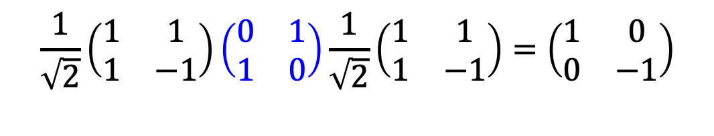


Constructing Controlled-Z Gates
H
X
H
Z
H
+
H
$$≡$$
Z
$$\frac{\text{1}}{\sqrt{\text{2}}}\left(\begin{matrix}\text{1} & \text{1} \\ \text{1} & \text{−1}\end{matrix}\right)\left(\begin{matrix}\text{0} & \text{1} \\ \text{1} & \text{0}\end{matrix}\right)\frac{\text{1}}{\sqrt{\text{2}}}\left(\begin{matrix}\text{1} & \text{1} \\ \text{1} & \text{−1}\end{matrix}\right)=\left(\begin{matrix}\text{1} & \text{0} \\ \text{0} & \text{−1}\end{matrix}\right)$$
$$≡$$
Z
H
+
H
Notes:
For larger problems with more than two qubits, Grover’s algorithm requires a multi-controlled Z (MCZ) operation, which is not always provided as a standard operation in quantum programming frameworks. However, the multi-controlled X (MCX) gate is commonly available.
The relation HXH=Z provides a simple way to construct an MCZ from an MCX. By placing Hadamard gates before and after the target qubit of an MCX gate, the controlled X operation is converted into a controlled Z operation.
In this way, the multi-controlled phase flips required by Grover’s algorithm can be implemented using commonly supported MCX gates.

Slide 21
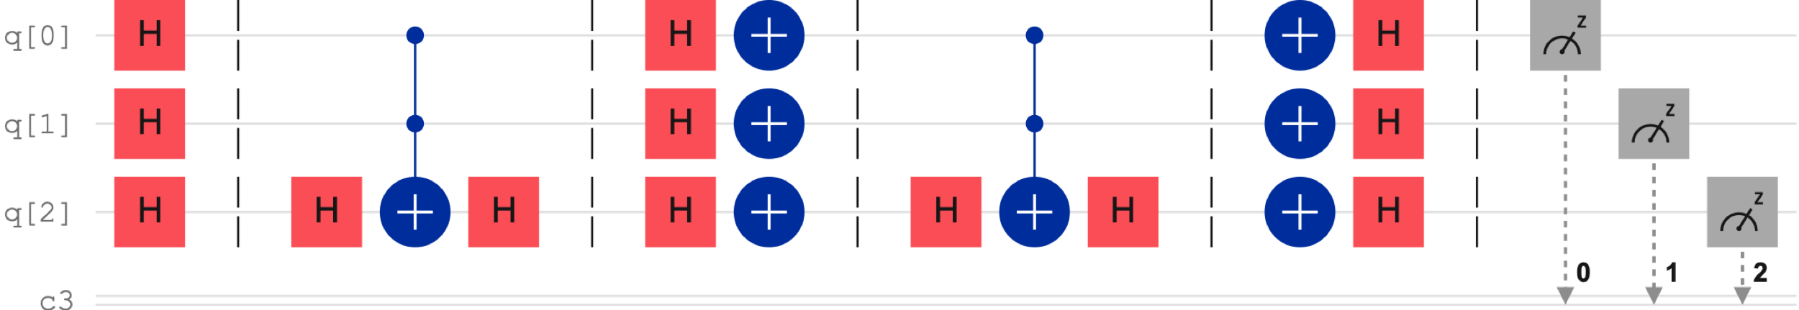
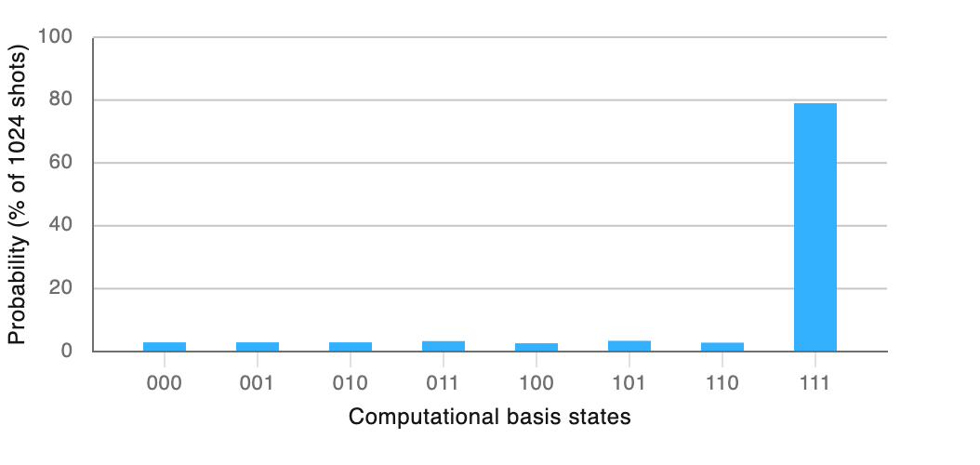
Grover’s Algorithm: Three-Qubit Circuit
Notes:
The figure shows the same Grover search pattern extended to a three-qubit circuit, giving a search space of N=8 possible states. In this example, the oracle is designed to mark the target state ∣111⟩ by flipping the sign of its amplitude. The diffuser then amplifies the marked state, increasing the probability of obtaining ∣111⟩ when the qubits are measured.

Slide 22


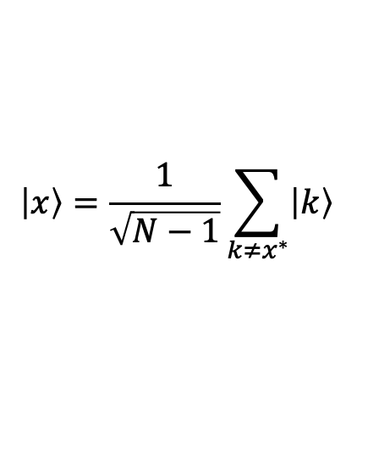
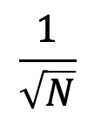
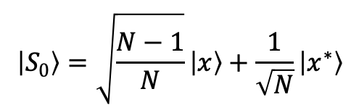


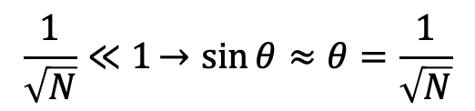

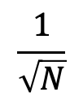
Geometric Interpretation of Grover’s Algorithm (1)
$$\left|x^{∗}\right\rangle$$
(solution)
amplitude
$$\frac{1}{\sqrt{N}}$$
$$\left|S_{0}\right\rangle =\sqrt{\frac{N−1}{N}}\left|x\right\rangle +\frac{1}{\sqrt{N}}\left|x^{∗}\right\rangle$$
$$\frac{1}{\sqrt{N}}$$
(initial state)
$$θ$$
$$\left|x\right\rangle =\frac{1}{\sqrt{N−1}}\sum_{k≠x^{∗}}{\left|k\right\rangle }$$
index
$$0$$
$$x^{∗}$$
$$N$$
(non-solutions)
$$\left|S_{0}\right\rangle =\sqrt{\frac{N−1}{N}}\left|x\right\rangle +\frac{1}{\sqrt{N}}\left|x^{∗}\right\rangle , \underset{→}{\left\langle x | x\right\rangle =1\text{, } \left\langle x^{∗} | x\right\rangle =0} cos{θ=\left\langle x | S_{0}\right\rangle =\sqrt{\frac{N−1}{N}}. \underset{→}{\cos^{2}θ+\sin^{2}θ=1}}\sin{θ=\frac{1}{\sqrt{N}}}$$
$$\frac{1}{\sqrt{N}}≪1→sin{θ≈θ=\frac{1}{\sqrt{N}}}$$
Notes:
Grover’s algorithm also has a useful geometric interpretation. Although the search space may contain many basis states, the algorithm can be represented in a two-dimensional plane defined by the target state and a normalized combination of all non-target states.
1. The target state is represented by the vertical vector $\left|x^{∗}\right\rangle$. All $N−1$ non-target states are combined into a single normalized vector $\left|x\right\rangle$
$$\left|x\right\rangle =\frac{1}{\sqrt{N−1}}\sum_{k≠x^{∗}}{\left|k\right\rangle }$$
These two vectors are orthogonal and define the two-dimensional search plane.
2. The initial equal superposition of all $N$ states s represented by the normalized vector $\left|S_{0}\right\rangle$. In this two-dimensional plane,
$$\left|S_{0}\right\rangle =\sqrt{\frac{N−1}{N}}\left|x\right\rangle +\frac{1}{\sqrt{N}}\left|x^{∗}\right\rangle$$
3. If $θ$ is the angle between $\left|S_{0}\right\rangle$ and the non-target direction $\left|x\right\rangle$, then
$$\cos{θ=\left\langle x | S_{0}\right\rangle =\sqrt{\frac{N−1}{N}}. \underset{→}{\cos^{2}θ+\sin^{2}θ=1}}\sin{θ=\frac{1}{\sqrt{N}}}$$
For a large search space, $1/{\sqrt{N}}≪1$, so $θ$ is small. Using the small-angle approximation $\sin{θ≈θ}$,
$$θ=\frac{1}{\sqrt{N}}$$

Slide 23






Geometric Interpretation of Grover’s Algorithm (2)
$$\left|x^{∗}\right\rangle$$
amplitude
$$\frac{1}{\sqrt{N}}$$
m
$$\frac{1}{\sqrt{N}}$$
$$\left|S_{0}\right\rangle$$
$$θ$$
$$θ$$
$$\left|x\right\rangle$$
index
$$0$$
$$x^{t}$$
$$N$$
$$\left|S_{1}\right\rangle$$
Notes:
After the oracle is applied, the state vector $\left|S_{0}\right\rangle$ is reflected about the non-target direction $\left|x\right\rangle$, producing the new state $\left|S_{1}\right\rangle$. Geometrically, this reflection changes the sign of the component along the target direction $\left|x^{∗}\right\rangle$, while leaving the component along $\left|x\right\rangle$ unchanged. As a result, the amplitude of the target state changes sign, which is exactly the phase flip performed by the oracle.
The angle between $\left|S_{0}\right\rangle$ and $\left|x\right\rangle$ is $θ$, so the reflected vector $\left|S_{1}\right\rangle$ lies at the same angle $θ$ on the opposite side of the ∣x⟩ axis.

Slide 24
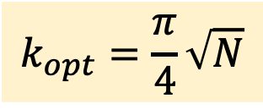
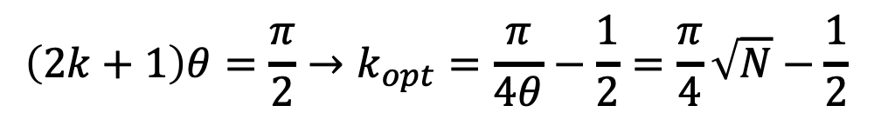



Geometric Interpretation of Grover’s Algorithm (3)
$$\left|x^{∗}\right\rangle$$
amplitude
$$\left|S_{2}\right\rangle$$
$$α$$
$$\frac{1}{\sqrt{N}}$$
$$\left|S_{0}\right\rangle$$
$$2θ$$
$$θ$$
$$θ$$
$$\left|x\right\rangle$$
index
$$0$$
$$x^{∗}$$
$$N$$
$$\left|S_{1}\right\rangle$$
$α=(\frac{π}{2}−$2$θ)−θ\underset{→}{k iterations}(\frac{π}{2}−\text{2}\text{k}θ)−θ=\frac{π}{2}−\left(2k+1\right)θ, where θ≈\frac{1}{\sqrt{N}}$
$$\left(2k+1\right)θ=\frac{π}{2}→k_{opt}=\frac{π}{4θ}−\frac{1}{2}=\frac{π}{4}\sqrt{N}−\frac{1}{2}$$
$$k_{opt}=\frac{π}{4}\sqrt{N}$$
Notes:
Applying the diffusion operator reflects the state $\left|S_{1}\right\rangle$ about the initial equal-superposition vector $\left|S_{0}\right\rangle$, producing a new state $\left|S_{2}\right\rangle$. This second reflection moves the state closer to the target direction $\left|x^{∗}\right\rangle$.
Together, the oracle and diffuser produce a rotation of approximately 2$θ$ toward the target. After $\text{k}$ iterations, the state has therefore rotated by approximately $\text{2}\text{k}θ$, in addition to its initial angle $θ$.
The target direction corresponds to an angle of $π/2$, so the optimal number of iterations occurs approximately when $\left(2k+1\right)θ≈π/2$. For large $N$, where $θ≈1/\sqrt{N}$​, this gives
$$k_{opt}=\frac{π}{4}\sqrt{N}$$
This is the geometric reason why Grover’s algorithm requires $O(\sqrt{N})$ iterations. The number of iterations is important. Continuing beyond the optimal point rotates the state past the target direction, reducing the probability of measuring the correct result.

Slide 25
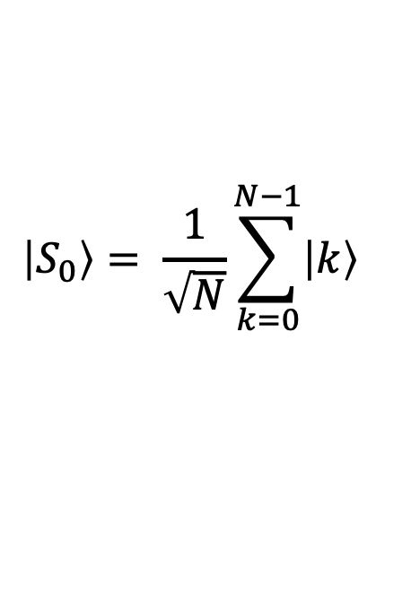
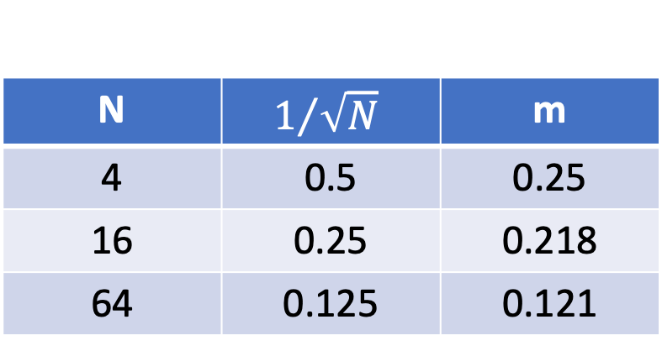
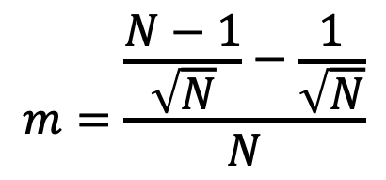
Why Reflect About the Initial Superposition?
N | $$1/{\sqrt{N}}$$ | m
4 | 0.5 | 0.25
16 | 0.25 | 0.218
64 | 0.125 | 0.121
$$\left|S_{0}\right\rangle = \frac{1}{\sqrt{N}}\sum_{k=0}^{N−1}{\left|k\right\rangle }$$
$$m=\frac{\frac{N−1}{\sqrt{N}}−\frac{1}{\sqrt{N}}}{N}$$
Notes:
In the initial equal superposition, every basis state has the same amplitude $1/\sqrt{N}$​. After the oracle flips the target amplitude, the new average becomes
$$m=\frac{\frac{N−1}{\sqrt{N}}−\frac{1}{\sqrt{N}}}{N}$$
The table shows that as $N$ increases, this average approaches the initial amplitude $1/\sqrt{N}$​. This explains geometrically why the diffuser can be viewed as a reflection about the initial equal-superposition direction $\left|S_{0}\right\rangle$.
After the oracle, the target amplitude changes from $1/\sqrt{N}$​ to $−1/\sqrt{N}$​. The diffuser reflects it about the mean:
$$2m+\frac{1}{\sqrt{N}}≈\frac{3}{\sqrt{N}}$$
With each Grover iteration, the target amplitude grows further while the other amplitudes decrease. This rapid amplification explains why only about $π\sqrt{N}/4$ iterations are needed.
For example, for a database with N=1,000,000 entries, a classical search would require about 500,000 queries on average, while Grover’s algorithm requires only about 785 iterations.

Slide 26


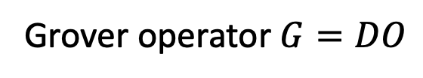






Grover’s Algorithm with Multiple Solutions
$$O=O_{1}O_{2}$$
$$H^{⨂2}$$
$$O_{1}$$
$$O_{2}$$
$$D$$
$$O_{1}$$
$$O_{2}$$
$$D$$
Grover operator $G=DO$
Grover iterations
Grover iterations
$$O=I−2\left|x^{∗}\right\rangle ⟨x^{∗}|$$
$$G=DO=\left(2\left|S\right\rangle ⟨S|−I\right)\left(I−2\left|x^{∗}\right\rangle ⟨x^{∗}|\right)$$
$$D=2\left|S\right\rangle ⟨S|−I$$
Notes:
For multiple solutions, the oracle can contain a separate marking block for each target state. If there are two target states, $O_{1}$​ marks the first solution and $O_{2}$​ marks the second. Together, these two marking operations form a single oracle $O=O_{1}O_{2}$.
Each Grover iteration consists of the complete oracle followed by the diffuser. Together, the oracle and diffuser form the Grover operator $G=DO$, where the oracle acts first and the diffuser acts second.
For a single target, $O=I−2\left|x^{∗}\right\rangle ⟨x^{∗}|, D=2\left|S\right\rangle ⟨S|−I$
so $G=\left(2\left|S\right\rangle ⟨S|−I\right)\left(I−2\left|x^{∗}\right\rangle ⟨x^{∗}|\right)$
For $M$ target states, the oracle contains $M$ marking blocks followed by one diffuser per Grover iteration. Since these marking blocks are phase-flip operators, their order does not affect the result.
If there are $M$ solutions among $N$ possible states, the approximate optimal number of iterations becomes
$$k_{opt}=\frac{π}{4}\sqrt{\frac{N}{M}}$$

Slide 27
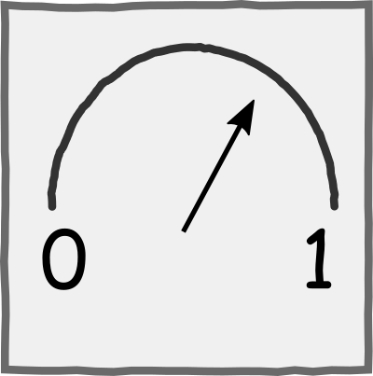

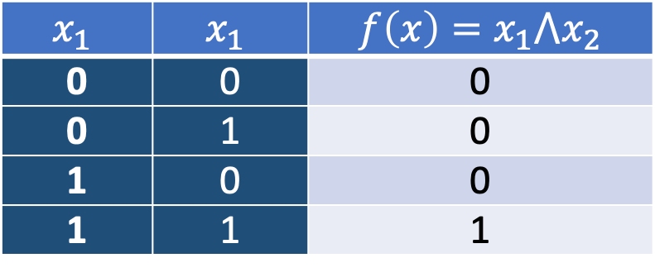

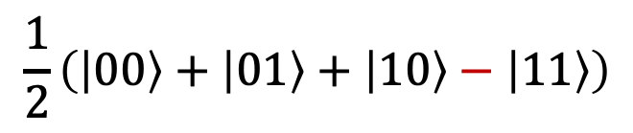
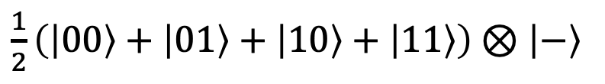

Grover’s Algorithm for SAT Problems
$$x_{1}$$ | $$x_{1}$$ | $$f\left(x\right)=x_{1}{⋀x}_{2}$$
0 | 0 | 0
0 | 1 | 0
1 | 0 | 0
1 | 1 | 1
$\left|0\right\rangle$
H
D
(amplification)
$\left|0\right\rangle$
H
$\left|0\right\rangle$
$$\frac{1}{2}\left(\left|00\right\rangle +\left|01\right\rangle +\left|10\right\rangle −\left|11\right\rangle \right)$$
+
H
+
$\frac{1}{2}\left(\left|00\right\rangle +\left|01\right\rangle +\left|10\right\rangle +\left|11\right\rangle \right)$ ⊗ $\left|−\right\rangle$
Notes:
Grover’s algorithm can also be used to solve Boolean satisfiability problems, or SAT problems. The goal is to find an assignment of Boolean variables that makes a given Boolean expression evaluate to True.
In this simple example, the Boolean function is $f\left(x\right)=x_{1}{⋀x}_{2}$. The truth table shows that the function is True only when both variables are 1, so the satisfying assignment is ∣11⟩.
To implement the oracle, the input qubits $x_{1}$​ and $x_{2}$​ are first placed in superposition, while an ancilla qubit is prepared in the ∣−⟩ state. Since the ancilla is prepared in the ∣−⟩ state, this action produces a phase flip through phase kickback, marking the satisfying state. For $f\left(x\right)=x_{1}{⋀x}_{2}$ the CCX directly implements the Boolean condition, since it is activated only when $x_{1}=x_{2}$. For more complicated SAT expressions, the oracle generally requires a circuit of multiple gates to evaluate the Boolean function.
The diffuser then amplifies the marked state, making the satisfying assignment ∣11⟩ the most likely measurement result. In this ideal N=4 example, a single Grover iteration returns ∣11⟩ with 100% probability.

Slide 28
Constraint Solving with Grover’s Algorithm
Problem: Alice is organizing Bob’s birthday party and wants to invite Chris, Daniel, and Emma.
However, Chris will attend the party only if Daniel comes without Emma.
f(C,D,E)=(¬C∨D)∧(¬C∨¬E)
000 001 010 011 100 101 110 111
Notes:
A simple SAT problem can be illustrated through event planning. Alice is organizing Bob’s birthday party and wants to invite Chris, Daniel, and Emma. However, Chris will attend the party only if Daniel comes without Emma. This requirement can be represented using Boolean variables describing whether each person attends.
Let C, D, and E represent the attendance of Chris, Daniel, and Emma, respectively. Since each variable can be either 0 or 1, the complete attendance pattern can be represented by a three-bit string CDE, giving 2³=8 possible combinations. The condition “if Chris attends, then Daniel attends and Emma does not” can be written as C→(D∧¬E), which in CNF form becomes (¬C∨D)∧(¬C∨¬E)​. The goal is to find an assignment of C,D,E that makes the complete Boolean expression True. In other words, all clauses must be satisfied simultaneously. Any assignment that satisfies all the conditions is a valid solution to the SAT problem.
Grover’s algorithm can then search through the possible assignments, with the oracle marking those that satisfy the complete Boolean expression. For this example, the satisfying assignments are 000, 001, 010, 011, 110​
Practical applications include cryptanalysis, where Grover’s algorithm can accelerate the search through a large space of possible cryptographic keys, as well as optimization and planning problems, such as traffic routing, circuit verification, and even aircraft design.

Slide 29


The efficiency of Grover’s algorithm
$$O(N)$$
$$O(\sqrt{N})$$
Notes:
The diagram compares the performance of a classical search with Grover’s algorithm. The blue line shows that the number of queries required by a classical search grows linearly with the size of the database. Grover’s algorithm, on the other hand, scales with the square root of the database size, providing a quadratic speedup.
This is a significant improvement, but it is not the exponential speedup achieved by some other quantum algorithms. Importantly, for unstructured search, Grover’s quadratic speedup is known to be optimal: no quantum algorithm can generally solve this problem with asymptotically fewer than $O(\sqrt{N})$ queries.

Slide 30
Shor’s Algorithm (1994)
Peter Shor developed a quantum algorithm for finding the prime factors of composite integers.
Shor’s algorithm provides an exponential speedup over the best-known classical factoring algorithms.
Shor P.W. Polynomial-time algorithms for prime factorization and discrete logarithms on a quantum computer, SIAM J. Comput., 26 (5) (1997), pp. 1484-1509,
Peter Shor (born 1959)
Notes:
Another landmark quantum algorithm is Shor’s algorithm, designed to find the prime factors of large composite numbers. It was developed by the American mathematician Peter Shor in 1994.
The algorithm is extremely important because it shows that a sufficiently powerful quantum computer could, in principle, break widely used public-key cryptographic systems such as RSA, whose security relies on the practical difficulty of factoring large numbers. Today’s quantum computers are still too small and error-prone to factor cryptographically significant numbers using Shor’s algorithm. However,
Reference:
Shor P.W. Polynomial-time algorithms for prime factorization and discrete logarithms on a quantum computer, SIAM J. Comput., 26 (5) (1997), pp. 1484-1509,
https://arxiv.org/abs/quant-ph/9508027

Slide 31


The Challenge of Prime Factorization.
Factoring is difficult
15 = ? ?
$$×$$
Multiplication is easy
3 5 = 15
$$×$$
Notes:
Prime factorization of a positive integer means expressing it as a product of prime numbers. While multiplying large numbers is computationally easy, finding the prime factors of a large number is much harder for classical computers and can become impractical as the number grows.
This computational difficulty is the basis of RSA cryptography. RSA uses a large number obtained by multiplying two large prime numbers. Multiplication is easy, but recovering those prime factors from the resulting number is extremely difficult for classical computers. For example, an RSA-2048 modulus contains 2048 bits, or about 617 decimal digits, and factoring such a number is considered infeasible with current classical computing methods.
A sufficiently large and fault-tolerant quantum computer could change this. Using Shor’s algorithm, an RSA-2048 modulus could, in principle, be factored in hours or days, depending on the quantum-computer architecture and available resources.
The point at which quantum computers become powerful enough to break widely used public-key cryptography is often called Q-Day, or Y2Q. This possibility is one of the main reasons for the current transition toward post-quantum cryptography.

Slide 32
MathBox: Mathematical Foundations of Shor’s Algorithm
modular arithmetic
period finding
number theory
Notes:
To understand Shor’s algorithm, it is useful to first review some theoretical foundations, including
modular arithmetic
number theory, and
period finding.

Slide 33

MathBox: Modular Arithmetic
(modulus)
(modulus)
congruence relation
$$\left.a≡b (mod n\right)⟺n|(a−b)$$
Notes:
Quantum computing makes extensive use of modular arithmetic. It is a type of arithmetic in which integers “wrap around” after reaching a certain value called the modulus.
A simple example is a 12-hour clock: after 12, we return to 1 again. Here, 12 is the modulus. This illustrates the periodic nature of modular arithmetic, where values repeat after a fixed interval.
In mathematics, modular arithmetic is described using a congruence relation
$$\left.a≡b (mod n\right)⟺n|(a−b)$$
It means:
$a$ is congruent to $b$ modulo $n$ if and only if $n$ divides $(a−b)$. Equivalently, $(a−b)$ is divisible by $n$.

Slide 34


MathBox Prime, Semiprime, and Composite Numbers
A prime number is a natural number greater than 1 that is divisible only by 1 and itself
A semiprime (or bi-prime) is a natural number that is the product of two prime numbers.
Example: $21 (3×7)$
13
A composite number is a natural number greater than 1 that is not prime.
Example: $20 (2×10)$
1
13
2, 3, 5, 7, 11, 13, 17, 19, …
Notes:
A prime number is a natural number greater than 1 that is divisible only by 1 and itself. Examples include 2,3,5,7,11,…
A semiprime (or biprime) is a natural number that is the product of exactly two prime numbers. For example, $21=3×7$
A composite number is a natural number greater than 1 that is not prime, meaning that it has factors other than 1 and itself. For example, $20=2×10$.
Every semiprime is composite, but not every composite number is semiprime. For example, 12 is composite but not semiprime.

Slide 35




The Greatest Common Divisor (GCD)
a and N are coprime if
$$gcd\left(a,N\right)=1$$
The greatest common divisor (GCD) of two nonzero integers is the largest positive integer that divides both numbers without a remainder
For coprime integers $a$ and $N>1$, the order of $a$ modulo $N$ is the smallest $r$ such that
$$\left.a^{r} ≡1 (mod N\right)$$
15
10
2
3
1
10
5
15
For a semiprime number$N=pq$
$$gcd\left(z, N\right)=p⇒q=\frac{N}{P}$$
$$gcd\left(10,15\right)=5$$
Notes:
The greatest common divisor (GCD) of two nonzero integers is the largest positive integer that divides both numbers without a remainder.
For example, the divisors of 10 are 1,2,5,10, while the divisors of 15 are 1,3,5,15. Their common divisors are 1 and 5, so gcd(10,15)=5.
If the GCD of two numbers is 1, the numbers are said to be coprime, or relatively prime: $gcd\left(a,N\right)=1$. For example, 8 and 9 are coprime because gcd(8,9)=1, even though neither number is prime.
For two coprime integers $a$ and $N>1$, the order of $a$ modulo $N$ is the smallest positive integer $r$ such that $\left.a^{r} ≡1 (mod N\right)$. This means that dividing $a^{r}$ by $N$ gives a remainder of 1, or equivalently, that $a^{r}−1$ is divisible by $N$. For example, for $a=2,N=3$, the order of $2$ modulo $3$ is $r=2$, because $\left.2^{2} ≡1 (mod 3\right)$. This is because 4 divided by 3 leaves a remainder of 1.
A key idea behind Shor’s algorithm is that if $N$ is the product of two primes, $N=pq$, finding a nontrivial GCD with $N$ can reveal one of its factors. Therefore, the factors $p$ and $q$ do not necessarily have to be found directly. It is enough to construct a number $z$ that shares a nontrivial factor with $N$, because $1<gcd \left(z,N\right)<N$.
For example, $N=21=3×7$ , and $gcd \left(6,21\right)=3$, $gcd \left(14,21\right)=7$. In these simple examples, 6 and 14 happen to share a prime factor with 21. Shor’s algorithm provides a systematic way to construct numbers with this useful property through period finding.

Slide 36




MathBox Euclidean Algorithm
Two observations:
gcd(a, 0) = |a| gcd(0, b) = |b|
gcd(a, b) = gcd(b, a mod b), a>b
Algorithm:
Repeatedly divide the previous divisor by the remainder until the remainder becomes zero.
The greatest common divisor is the last non-zero remainder.
$$gcd\left(30,8\right):$$
def gcd(a,b):
if b == 0 : return a
return gcd(b, a % b)
$$30 \% 8=6$$
$$8 \% 6=2$$
$$6 \% 2=0$$
Notes:
An efficient method for finding the greatest common divisor (GCD) is the Euclidean algorithm. The algorithm is based on two simple observations:
The GCD of any number and 0 is the absolute value of that number: gcd (a,0)=∣a∣.
For a>b>0, the GCD of a and b is the same as the GCD of b and the remainder obtained when a is divided by b: gcd (a,b) = gcd (b,a mod b).
The Euclidean algorithm repeatedly applies this relation until the remainder becomes zero. The last nonzero remainder is the GCD.

Slide 37
Shor’s Algorithm in a Nutshell
Let $N=pq$ where $p$ and $q$ are prime numbers.
Let 𝑁=𝑝𝑞 where 𝑝 and 𝑞 are prime numbers.
If $z$ shares a nontrivial factor with $N$, then $gcd\left(z,N\right)$ can reveal $p$ or $q$.
If 𝑧 shares a nontrivial factor with 𝑁, then 𝑔𝑐𝑑(𝑧,𝑁) can reveal 𝑝 or 𝑞.
Therefore, factoring $N$ is reduced to the problem of finding the period $r$
Therefore, factoring 𝑁 is reduced to the problem of finding the period 𝑟
Shor constructs such numbers as $z=a^{r/2}±1$ where $∎ a<N$ is a random integer, such that $gcd\left(a,N\right)=1$ $∎ r$ is the period of ${f\left(x\right)=a}^{x}(mod N)$
Shor constructs such numbers as 𝑧=𝑎^(𝑟/2)±1 where ∎ 𝑎<𝑁 is a random integer, such that gcd(𝑎,𝑁)=1 ∎ 𝑟 is the period of 〖𝑓(𝑥)=𝑎〗^𝑥 (mod 𝑁)
Notes:
A key idea behind Shor’s algorithm is that if $N$ is the product of two prime numbers $p$ and $q$, the factors do not need to be found directly. Instead, finding the GCD of $N$ with another number that shares a nontrivial factor with $N$ can reveal either $p$ or $q$.
For this purpose, Shor’s algorithm uses the numbers
$$a^{r/2}−1,a^{r/2}+1$$
where $1<a<N$ is chosen to be coprime with $N$, so $gcd\left(a,N\right)=1$, and $r$ is the period of the modular function
$${f\left(x\right)=a}^{x}(mod N)$$
The factors can then be obtained from
$${gcd(a}^{r/2}−1), {gcd (a}^{r/2}+1)$$
This reduces the factoring problem to the problem of finding the period r, which is the key task performed by the quantum part of Shor’s algorithm.

Slide 38


From Period Finding to Factorization
$$a^{0}mod N, a^{1}mod N, a^{2}mod N, ⋯$$
$$7^{0}mod 15$$ | $$7^{1}mod 15$$ | $$7^{2}mod 15$$ | $$7^{3}mod 15$$ | $$7^{4}mod 15$$ | $$7^{5}mod 15$$
1 | 7 | 4 | 13 | 1 | 7
$$\begin{matrix}a^{r} & ≡ & 1\left(mod N\right) \\ a^{r}−1 & = & kN, \\ \left(a^{\frac{r}{2}}+1\right)\left(a^{\frac{r}{2}}−1\right) & = & kN \\ & & \end{matrix}$$
$$k∈ℕ$$
$$If N=pq ⟶\begin{matrix}p=gcd\left(a^{\frac{r}{2}}+1,N\right), & q=gcd\left(a^{\frac{r}{2}}−1,N\right)\end{matrix}$$
Notes:
Since period finding is the key step in Shor’s algorithm, consider the sequence generated by the modular exponential function $a^{x} mod N$. The table shows an example for $a=7$ and $N=15$. The sequence starts at 1 and eventually repeats, returning to 1.
The length of this repeating cycle is the order, or period $r$ of $a$ modulo $N$. By definition, $a^{r}≡1\left(mod N\right)$. This means that $a^{r}−1$ is divisible by $N$, so it can be written as $a^{r}−1=kN$, where $k$ is an integer. If $r$ is even, the left-hand side can be factored as $a^{r}−1=\left(a^{r/2}+1\right)\left(a^{r/2}−1\right)=kN$
If $N=pq$, the factors can then be obtained by computing $\begin{matrix}p=gcd\left(a^{\frac{r}{2}}+1,N\right), & q=gcd\left(a^{\frac{r}{2}}−1,N\right)\end{matrix}$ provided these GCDs are nontrivial. In this way, integer factorization is reduced to the problem of finding the period $r$ of the function $a^{x} mod N$.

Slide 39


Classical Period Finding: $f\left(x\right)= a^{x}mod N$
Period finding
For a given function $f\left(x\right)=a^{x}mod N$, Starting from$f\left(0\right)=1$, find the smallest $r$ for which$f\left(r\right)=1$
For a given function 𝑓(𝑥)=𝑎^𝑥 mod 𝑁, Starting from 𝑓(0)=1, find the smallest 𝑟 for which 𝑓(𝑟)=1
$$f\left(x\right)=a^{x} mod N\underset{→}{a=7, N=15 }7^{x}mod N$$
$$x$$ | $$7^{x}mod 15$$
0 | 1
1 | 7
2 | 4
3 | 13
4 | 1
5 | 7
period $=4$
Notes:
The table shows how the period of the function $f\left(x\right)=a^{x} mod N$ can be found using a classical method.
Starting with $f\left(0\right)=1$, the function is evaluated step by step as $x$ increases. Eventually, the sequence returns to 1 and begins to repeat. The smallest positive value of $x$ for which this happens gives the period $r$.
In this example, the function first returns to 1 at $x=4$. So the period of the function is 4.

Slide 40





Shor’s Factoring Algorithm: Step by Step
random integer $a$
$$2<a<N$$
Y
$$\left\{\begin{aligned}p=a \\ q=N/a\end{aligned}\right.$$
$$gcd\left(a,N\right)>1 ?$$
N
find the period $r$ of
$$a^{x} mod N$$
Q
$\left(a^{r/2}+1\right)\left(a^{r/2}−1\right)$ $≡0 (mod N)$
$1) r$is even. &
2)${ a}^{r/2}≢−1 \left(mod N\right)$
N
Y
$$p,q=gcd⁡(a^{r/2}±1,N)$$
Notes:
By combining these mathematical principles into a coherent procedure, Shor’s algorithm can be represented by a flowchart for factoring a semiprime number $N$.
The algorithm begins by selecting a random integer a such that$1<a<N$.
The value $gcd\left(a,N\right)$ is calculated. If $gcd\left(a,N\right)>1$ then a nontrivial factor of $N$ has already been found, and the other factor is $N/gcd\left(a,N\right)$. Otherwise, $a$ and $N$ are coprime, and the algorithm continues.
The next step is the quantum core of Shor’s algorithm: finding the period $r$ of the modular exponential function $a^{x} mod N$. This is the part performed using quantum period finding.
For the period $r$ to produce nontrivial factors, two conditions must be satisfied:
$r$ must be even, so that $r/2$ is an integer.
${ a}^{r/2}≢−1 \left(mod N\right)$, so that ${ a}^{r/2}+1$ is not a multiple of $N$, avoiding the trivial factor.
If these conditions are not satisfied, another value of $a$ is selected and the procedure is repeated.
If the conditions are satisfied, the factors can be obtained from
$$p=gcd\left(a^{\frac{r}{2}}−1,N\right), q=gcd\left(a^{\frac{r}{2}}+1,N\right)$$
Shor’s algorithm does not necessarily succeed on the first attempt. Some choices of a produce a period that does not lead to nontrivial factors. In that case, another random value of $a$ is chosen and the procedure is repeated. Importantly, the probability of obtaining a useful result is sufficiently high that only a small number of repetitions is typically required.

Slide 41




Shor’s Algorithm: Factoring N = 15
N= $pq$=15$, a=7$
the period of $7^{x}mod 15$ is $r=4$
$r=4$ is even &
$$a^{r/2}+1=50 ≢0 \left(mod 15\right)$$
$$a^{r/2}−1=48 ≢0 (mod 15)$$
D
$$p=gcd\left(a^{r/2}+1,N\right)=gcd\left(7^{2}+1, 15\right)=5$$
$$q=gcd\left(a^{r/2}−1,N\right)=gcd\left(7^{2}−1, 15\right)=3$$
Notes:
The classical part of Shor’s algorithm can be illustrated using the example $N=15$.
A random number $a=7$ is selected.
The period of the function $7^{x} mod 15$ was previously found to be 4.
The required conditions are satisfied:
The period$r$ is even, and ${ 7}^{r/2}−1=48$, ${ 7}^{r/2}+1=59$ and neither value is divisible by 15.
The factors are then obtained by computing the greatest common divisors: $p=gcd\left(48,15\right)=3, gcd\left(50, 15\right)=5$

Slide 42





The Challenge of Classical Period Finding
$$f(x)$$
10
8
6
. . .
4
2
0
2
4
6
8
10
M-1
$$x$$
$$M={10}^{100}$$
$$r$$
With the birthday paradox:
$For M={10}^{100}$: number of checks $\sim \sqrt{M}={10}^{50}$
Notes:
Finding the period of a function over a very large domain can be extremely difficult for a classical computer. Suppose a periodic function $f(x)$ is defined over $M$ possible inputs, where $M$ is very large, and the goal is to determine its period $r$.
One classical approach is to evaluate the function at different inputs and look for a collision: two different inputs $x_{1}$​ and $x_{2}$​ for which $f\left(x_{1}\right)=f\left(x_{2}\right)$. For a periodic function, such repetitions can provide information about the period, since the difference $x_{2}−x_{1}$​ may be related to r.
The birthday paradox shows that collisions can occur much sooner than might initially be expected. For example, among only 23 people there is already about a 50% probability that two share the same birthday. Even with this advantage, however, collision-based searches over extremely large spaces can require an enormous number of function evaluations. For an unstructured collision search among $M={10}^{100}$, possible values, the birthday paradox suggests that a collision may be found after approximately$\sqrt{M}={10}^{50}$ samples.

Slide 43














Quantum Period Finding
$$x$$
0
1
2
3
4
5
6
7
8
9
10
11
12
13
14
15
$$7^{x}mod 15$$
1
7
4
13
1
7
4
13
1
7
4
13
1
7
4
13
$$x$$
3
7
11
15
$$7^{x}mod 15$$
13
13
13
13
3
QFT$†$
$$\left.|0\right\rangle$$
H
7
$$\left.|0\right\rangle$$
H
k/r
$$x$$
11
$$\left.|0\right\rangle$$
H
15
$$\left.|0\right\rangle$$
H
$$\left.|0\right\rangle$$
$$7^{x}(mod 15)$$
$${(a}^{x} mod N)$$
$$\left.|0\right\rangle$$
M=13
$$y$$
$$\left.|0\right\rangle$$
$$\left.|0\right\rangle$$
Notes:
Quantum period finding takes a fundamentally different approach, using superposition and the Quantum Fourier Transform to extract periodic information efficiently. This forms the quantum core of Shor’s algorithm, where the goal is to determine the period of the modular function$f\left(x\right)= a^{x}mod N$. The figure shows the conceptual structure of the quantum circuit using the example $N=15$ and $a=7$.
Structure of the quantum circuit
The circuit consists of two quantum registers.
The first register, labelled $x$, is prepared in a uniform superposition of all possible input values for the function $a^{x} mod N$. In this example, a 4-qubit register represents the values $x=0,1,⋯,15.$ The $x$-register contains $n_{x}=4$ qubits and can therefore represent $Q=2^{n_{x}}$ basis states. In Shor’s algorithm, $Q$ is typically chosen such that $N^{2}≤Q≤{2N}^{2}$. This provides enough precision to recover the period from the final measurement.
The second register, labelled $y$, stores the corresponding function values $y=f\left(x\right)= a^{x}mod N$. It therefore needs $n_{y}$ qubits, enough to represent values from 0 to $N−1$, so typically $2^{n_{y}}≥N$. The first table shows the values of $x$together with their corresponding function values $f\left(x\right)$.
Measurement of the y-register
The $y$-register can now be measured. Suppose the measurement gives $y=13$. The joint state then collapses so that only the $x$-values associated with $f\left(x\right)=13$ remain. In this example, $x=3,7,11,15$. These values are separated by 4, reflecting the period $r=4$. However, directly measuring the $x$-register would reveal only one of these values and would not directly reveal the spacing between them. Instead, Shor’s algorithm uses the Inverse Quantum Fourier Transform to extract this periodic structure.
Applying the Inverse Quantum Fourier Transform
The IQFT transforms the evenly spaced pattern in the $x$-register into peaks associated with the periodicity. For the idealized example with $Q=16$ and $r=4$, the peaks occur at 0,4,8,12, which correspond, after division by $Q=16$ to 0, 1/4, 2/4, and 3/4​. These values have the general form $j/r$.
Measurement of the x-register
Finally, the $r$-register is measured. The measured integer $m$ gives the ratio
$$\frac{m}{Q}≈\frac{j}{r}$$
From this fraction, the period $r$ can be recovered classically, typically using the continued-fractions algorithm.

Slide 44


Quantum Period-Finding Circuit
$$\left.|0\right\rangle$$
H
U
$$a^{x} mod N$$
QFT$†$
$$\left.|0\right\rangle$$
H
$$x$$
$$\left.|0\right\rangle$$
H
$$\left.|0\right\rangle$$
H
$$\left.|0\right\rangle$$
$$\left.|0\right\rangle$$
$$y$$
$$\left.|0\right\rangle$$
$$\left.|0\right\rangle$$
$$\left.|x\right\rangle \left.||y\right\rangle →\left.|x\right\rangle \left.|a^{x} mod N\right\rangle$$
Notes:
The figure shows a block diagram of the quantum period-finding circuit. It consists of the main stages introduced previously, which will be examined individually

Slide 45





initialization:
$$\left.|x\right\rangle \left.|y\right\rangle ={\left.|0\right\rangle }^{⨂4}{\left.|0\right\rangle }^{⨂4}$$
$$\left(H^{⨂4}\left.|\text{0}\right\rangle \right) {\left.|0\right\rangle }^{⨂4}=\frac{1}{4}\left(\left.|\text{0}\right\rangle +\left.|\text{1}\right\rangle +⋯\left.+|\text{15}\right\rangle \right){\left.|0\right\rangle }^{⨂4}$$
step 1:
0
1
2
3
step 2:
$$\left.|x\right\rangle \left.|y\right\rangle →\left.|x\right\rangle \left.|a^{x} mod N\right\rangle =\left.|x\right\rangle \left.|7^{x} mod 15\right\rangle$$
$$\frac{1}{4}\left(\left.|\text{0} \right\rangle \left.|7^{0} mod 15\right\rangle +\left.|\text{1} \right\rangle \left.|7^{1} mod 15\right\rangle +⋯\left.+|\text{15} \right\rangle \left.|7^{15} mod 15\right\rangle \right)$$
$$\frac{1}{4}\left(\left.|\text{0} \right\rangle \left.|1\right\rangle +\left.|\text{1} \right\rangle \left.|7\right\rangle +\left.|\text{2} \right\rangle \left.|4\right\rangle +\left.|\text{3} \right\rangle \left.|13\right\rangle +\left.|\text{4} \right\rangle \left.|1\right\rangle +\left.|\text{5} \right\rangle \left.|7\right\rangle +⋯+\left.|\text{1}\text{5} \right\rangle \left.|13\right\rangle \right)$$
step 3:
measurement of $y$ yields : 1, 7, 4 or 13
Notes:
As a simple theoretical example, consider factoring the number $N=15$. The circuit uses two quantum registers, $x$ and $y$, both initially in the zero state. The combined initial state can be written as the product of the two register states.
Step 1: The $x$-register is placed in an equal superposition representing the integers from 0 to 15, while the $y$-register remains in the state ∣0⟩.
Step 2: The modular function $f\left(x\right)= a^{x}mod N$ is computed and stored in the $y$-register, with $a=7$ built into the circuit. The function values follow the repeating sequence 1,7,4,13,1,7,4,13,… clearly showing a period of 4.
Step 3: The $y$-register is measured, giving one of the four possible function values 1,7,4, or 13, each with equal probability in this ideal example. This measurement leaves the $x$-register in a superposition of the input values associated with the measured function value.

Slide 46








step 3:
$$\frac{1}{4}\left\{\begin{matrix}\left.| \text{0} \right\rangle \left.|1\right\rangle & + & \left.| \text{1} \right\rangle \left.|7\right\rangle & + & \left.| \text{2} \right\rangle \left.|4\right\rangle & + & \left.| \text{3} \right\rangle \left.|13\right\rangle & + \\ \left.| \text{4} \right\rangle \left.|1\right\rangle & + & \left.| \text{5} \right\rangle \left.|7\right\rangle & + & \left.| \text{6} \right\rangle \left.|4\right\rangle & + & \left.| \text{7} \right\rangle \left.|13\right\rangle & + \\ \left.| \text{8} \right\rangle \left.|1\right\rangle & + & \left.| \text{9} \right\rangle \left.|7\right\rangle & + & \left.|\text{10} \right\rangle \left.|4\right\rangle & + & \left.|\text{11} \right\rangle \left.|13\right\rangle & + \\ \left.|\text{12} \right\rangle \left.|1\right\rangle & + & \left.|\text{13} \right\rangle \left.|7\right\rangle & + & \left.|\text{14} \right\rangle \left.|4\right\rangle & + & \left.|\text{15} \right\rangle \left.|13\right\rangle & \end{matrix}\right\}$$
3
4
$$\left.y\text{ =13}→|x\right\rangle \left.|y\right\rangle =\frac{1}{2}\left(\left.|\text{ 3} \right\rangle +\left.| \text{7} \right\rangle +\left.| \text{11} \right\rangle +\left.| \text{15} \right\rangle \right)⨂\left.|13\right\rangle$$
$${QFT}^{†}|\left.x\right\rangle ={QFT}^{†}\left(\frac{1}{2}\left(\left.|3\right\rangle +\left.|7\right\rangle +\left.|11\right\rangle +\left.|15\right\rangle \right)\right)$$
step 4 ($IQFT)$:
$${QFT}^{†}|\left.x_{i}\right\rangle =\frac{1}{\sqrt{Q}}\sum_{k=0}^{Q−1}{e^{−\frac{2πi}{Q}x_{i}k}\left.|k\right\rangle }, {Q=2^{n_{x}}, x}_{i}∈3,7,11,15$$
$${QFT}^{†}|\left.x\right\rangle =\frac{1}{2}\frac{1}{\sqrt{Q}}\sum_{k=0}^{Q−1}{\left(\sum_{x∈3,7,11,15}{e^{−\frac{2πi}{Q}x_{i}k}}\right)\left.|k\right\rangle }$$
$${QFT}^{†}|\left.x\right\rangle =\frac{1}{8}\left(4\left.|0\right\rangle +4i\left.|4\right\rangle −4\left.|8\right\rangle \left.−4i|12\right\rangle \right)$$
For $Q=16$:
Notes:
Step 3 (continued): Consider the state of the $x$-register after measuring the $y$-register. Suppose the measurement gives $y=13$. The state must now be consistent with this outcome, so all components associated with other $y$-values disappear. Only $x=3,7,11,5$ remain in superposition. The amplitudes of these states are then renormalized from 1/4 to 1/2. Since all four surviving amplitudes remain equal, their relative probabilities are unchanged.
Step 4: The inverse QFT is then applied to the $x$-register. Each of the states$\left.|3\right\rangle ,\left.|7\right\rangle$,$\left.|11\right\rangle ,$ $\left.|15\right\rangle$ is transformed into a superposition with different phases. When these contributions combine, destructive interference cancels most outcomes, while constructive interference produces strong peaks at ∣0⟩,∣4⟩,∣8⟩,∣12⟩. These peaks therefore contain the information needed to determine the period $r=4$.

Slide 47









step 5: measurement of the $x$-register :
$${QFT}^{†}|\left.x\right\rangle =\frac{1}{8}\left(4\left.|0\right\rangle +4i\left.|4\right\rangle −4\left.|8\right\rangle \left.−4i|12\right\rangle \right)⇒x=0, 4,8,12$$
5
step 6: classical post-processing:
$$\frac{x}{Q}≈\frac{j}{r}$$
the period $r$satisfies the relation
$x$=measurement result, $Q=2^{n_{x}}$, $j$=int
$x=4$
$$\frac{x}{Q}≈\frac{j}{r} ⟹ \frac{4}{16}≈\frac{j}{r}\underset{→}{j=1}⟹r=4$$
x$=8$
$$\frac{x}{Q}≈\frac{j}{r} ⟹ \frac{8}{16}≈\frac{j}{r}\underset{→}{j=1}⟹r=2$$
$a^{r}≡1 (mod N)$
$r$ is even, $a^{r/2}≢−1 (mod N))$
$a^{r}≡1 \left(mod N\right) ×$
$r$ is even, $a^{r/2}≢−1 (mod N))$
$$p=gcd\left(a^{r/2}+1,N\right)=gcd\left(7^{2}+1,15\right)=5$$
$$q=gcd\left(a^{r/2}−1,N\right)=gcd\left(7^{2}−1,15\right)=3$$
Notes:
Step 5: In the final quantum step, the $x$-register is measured. In this ideal example, the possible outcomes are $x=0,4,8,12$, each with equal probability. A nonzero result contains information about the period $r$ of the modular function. At this point, the quantum circuit has completed its task, and the period is recovered through classical post-processing.
Step 6 (classical post-processing): The measured value $x$ is normalized by the number of basis states $Q=2^{n_{x}}$
$$\frac{x}{Q}≈\frac{j}{r}$$
where $j$ is an integer. From this fraction, a candidate for $r$ can be obtained. The candidate must then be verified by checking $a^{r}≡1 (mod N)$. In other words, $a^{r}−1$ must be divisible by $N$. If this condition is not satisfied, the candidate is rejected and another candidate or another measurement is required. Once $r$ has been confirmed as a valid period, it must satisfy the two additional conditions required for factorization: $r$ must be even, and $a^{r/2}≢−1 (mod N)$, i.e. $a^{r/2}+1$ is not divisible by $N$. If these conditions are satisfied, the GCD calculations can then be used to obtain the nontrivial factors of $N$.
Example 1: $x=4,Q=16$
$$\frac{x}{Q}≈\frac{j}{r} ⟹ \frac{4}{16}≈\frac{j}{r}$$
Therefore, $j/r=1/4$ gives the candidate $r=4$. This is indeed the period, since$7^{4}≡1(mod 15)$. The factors are then $p=\gcd\left(7^{2}−1,15\right)=3$ and $q=\gcd\left(7^{2}+1,15\right)=5$.
Example 2: $x=8,Q=16$
$$\frac{x}{Q}≈\frac{j}{r} ⟹ \frac{8}{16}=\frac{1}{2}≈\frac{j}{r}$$
This suggests $r=2$ as a candidate period. Substituting $r=2$ gives $7^{2} mod 15=4≠1$, so $r=2$ is not the actual period and must be rejected.
What happened is that the measurement corresponds to$j/r=2/4$​, which reduces to 1/2. By reducing the fraction, some information about the actual period $r=4$ is lost. In this case, another measurement or additional classical processing is needed to recover the correct period.
This shows that a single measurement does not always reveal the complete period, so Shor’s quantum period-finding procedure may need to be repeated.

Slide 48

The efficiency of Shor’s algorithm
Classical (NFS): ~1,000,000 years
Quantum (Shor): ~100 seconds
Estimated execution times depend strongly on the assumed classical and quantum architectures.
DOI:10.1142/9789812814623_0029
Notes:
The efficiency of Shor’s algorithm is best seen by comparing it with the best classical factoring method, the Number Field Sieve (NFS). The graph shows theoretical estimates of execution time under specific assumptions about classical and quantum computer architectures.
According to these estimates, factoring a 1024-bit number could take a classical supercomputer about one million years, while a fault-tolerant quantum computer running Shor’s algorithm could perform the same factorization in just over 100 seconds.
These numbers should be understood as theoretical estimates rather than actual measured execution times. The exact values depend strongly on assumptions about the hardware, including gate speed, connectivity, parallelism, and available quantum resources. Nevertheless, the comparison illustrates the potentially enormous computational advantage provided by Shor’s algorithm.

Slide 49
Why Shor’s Algorithm Is Not Yet Practical
Notes:
Shor’s algorithm is mathematically efficient, but the main limitation to its practical application today is quantum hardware.
Factoring large numbers requires many reliable logical qubits, while implementing a single logical qubit using quantum error correction may require many physical qubits. In addition, modular exponentiation, which is a key part of Shor’s algorithm, requires very deep quantum circuits with a large number of operations. On today’s quantum computers, gate errors and decoherence accumulate during the execution of such complex circuits.
For this reason, practical applications of Shor’s algorithm for large numbers require quantum error correction and, ultimately, a large fault-tolerant quantum computer.
So, the problem is not Shor’s algorithm itself. The algorithm exists and is theoretically ready, but quantum hardware has not yet reached the level required for its practical application to cryptographically significant numbers.

Slide 50

Questions?

